Slide 1
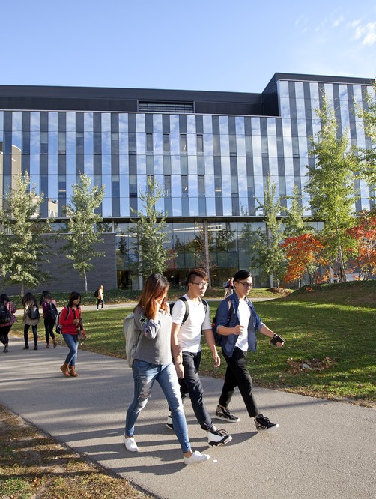
What can our discipline do?
Panel Discussant: Myra Fernandes
Department of Psychology

Slide 2
Thoughts from the Survey…
Representation
Leadership
Awards
How to make our field great?
Imposter Syndrome
Mentoring
Internationalization
What are we researching?
Who are we studying?

Slide 3
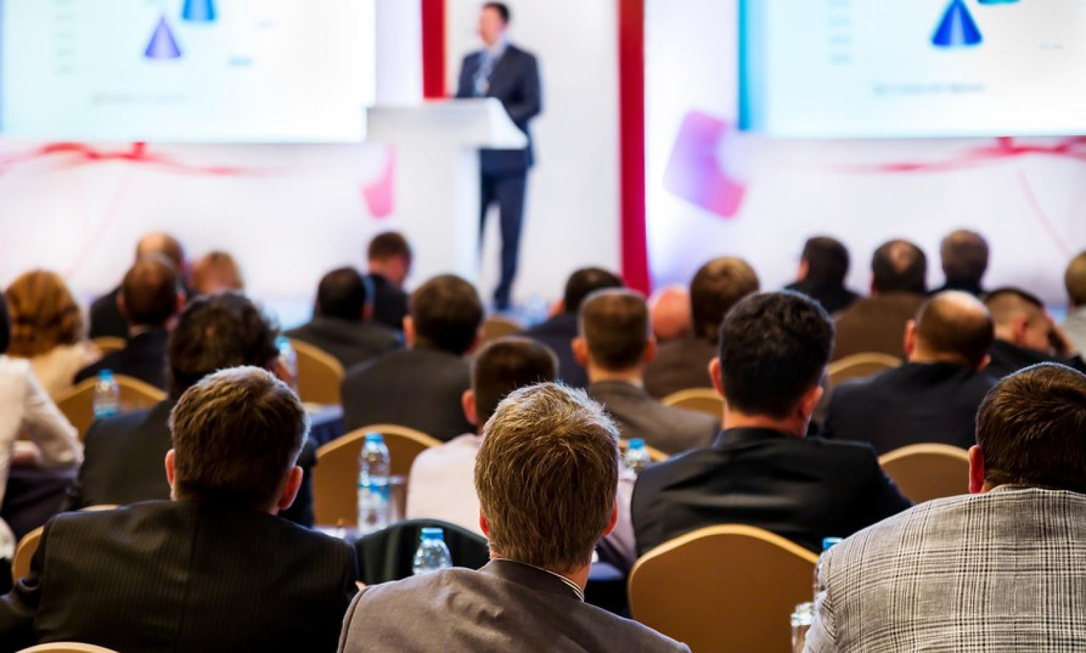
Representation
Who gets speaking time at conferences?
Who gets space in journals?

Slide 4
Poll Question…
conferences

Slide 5
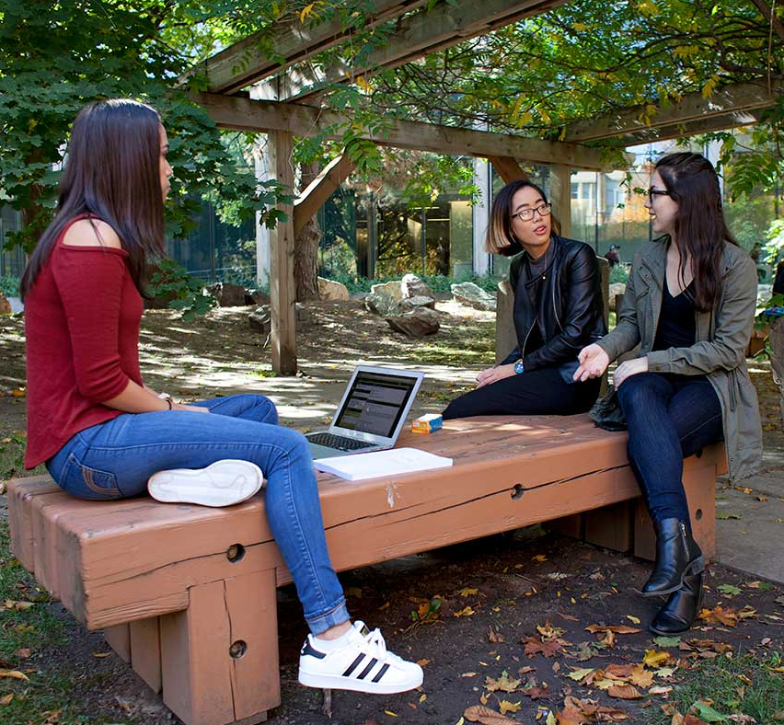
Leadership
Needed to invoke change?
How to make an impact?
Conference organisors
Departmental committees
Allow more voices

Slide 6
Poll Question…
Issues facing trainees

Slide 7
Awards
Nomination process
Selections
Grants

Slide 8
Poll Question…
Future options to consider

Slide 9
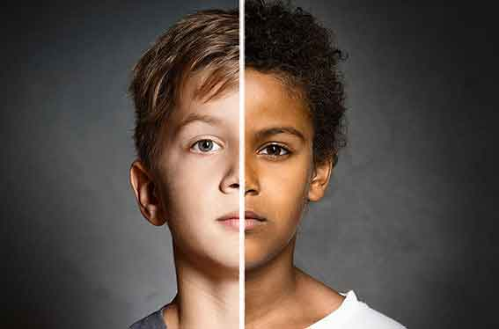
What and Who are we studying?
Biases?
Agism
Racism
Gender effects
Sex differences

Slide 10
More ideas to invoke change?
Thank You !

